Slide 1
WHY STUDY THEOLOGY?
ST PATRICK’S COLLEGE MAYNOOTH

Slide 2
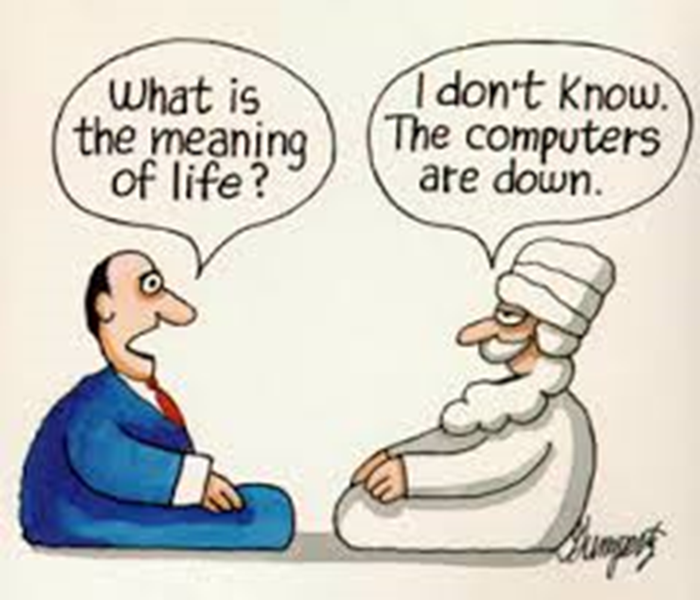

Slide 3
ETHICAL QUESTIONS
Can any war be really justified?

Slide 4
ETHICAL QUESTIONS
When could it be right to turn off a life-support machine?

Slide 5
QUESTIONS ABOUT FAITH
How can we know if there is a God?

Slide 6
QUESTIONS ABOUT SCRIPTURE
What do we know about the historical life of Jesus?

Slide 7
QUESTIONS ABOUT SCRIPTURE
Did God make the world in seven days?

Slide 8
QUESTIONS ABOUT SCRIPTURE
How did the prophet Amos inspire Martin Luther King?

Slide 9
EXPLORING LITURGY
Why is 1st Holy Communion so important?

Slide 10
EXPLORING WORLD RELIGIONS
What do other religions believe?

Slide 11
CHOICE BETWEEN TWO COURSES
BATh = Bachelors in Arts and Theology.
Joint degree combining Theology with another subject such as Music, Spanish, English, Business, History, Geography, Philosophy etc.
OR:
BTh = Bachelors in Theology.
Single subject Theology.

Slide 12
SOME OF OUR COURSES
> Christianity and World Religions
> Christian Anthropology
> Engaging Ethical Dilemmas
> History of Christianity
> Contemporary Issues in Bioethics
> God and Suffering

Slide 13
MORE OF OUR COURSES
> Religious Education in Secondary School
> Christian Sacraments
> Ecumenical and Inter-Religious Dialogue
> The God of Jesus Christ
> Prophetic Writings of the Old Testament
> Philosophy of Religion
> Christian Faith and Contemporary Culture

Slide 14
TRANSFERABLE SKILLS GAINED
Skill/confidence in written communication and verbal expression
Greater understanding of other viewpoints
Exploration of ethical questions from various perspectives
Awareness of how history has influenced today’s world
Critical thinking and philosophical inquiry
Understanding of how religious views have often shaped society
Engagement with big questions of life

Slide 15
Recent graduates of Theology & Arts have entered into THESE careers:
> Teaching > Marketing
> Business > Pastoral Work
> Communications > Publishing
> Journalism > Public Relations
> Finance > Social Services

Slide 16
MORE CAREERS OF OUR GRADUATES
> The Civil Service > Public / Private Sectors
> Administration > Community Development
> R.E. Project Co-ordinator > Research Administrator
> School Chaplaincy > Healthcare Chaplaincy
> Third Level Chaplaincy > Parish Administration

Slide 17
WHY NOT STUDY THEOLOGY HERE?

